Slide 1

Cadence
PCB Design for CCS
One Chip Design
SHIN HONGMIN

Slide 2

INDEX
Program & Tool
Design for ~~ Circuit
Procedure of PCB Design

Slide 3
Program & Tool
Cadence

Slide 4
Design for ~~ Circuit

Slide 5
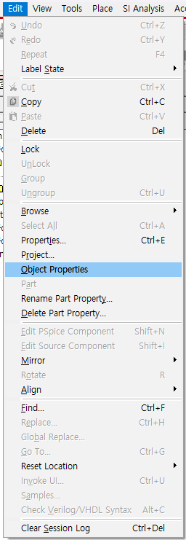
Procedure of PCB Design

Slide 6
Procedure of PCB Design

Slide 7


CONTACT
E-mail
s5748766@gmail.com
Phone
+82 010-9603-8799

